Slide 1
Lab Final Presentation
Jacob Howard
ELEC 3040/3050

Slide 2
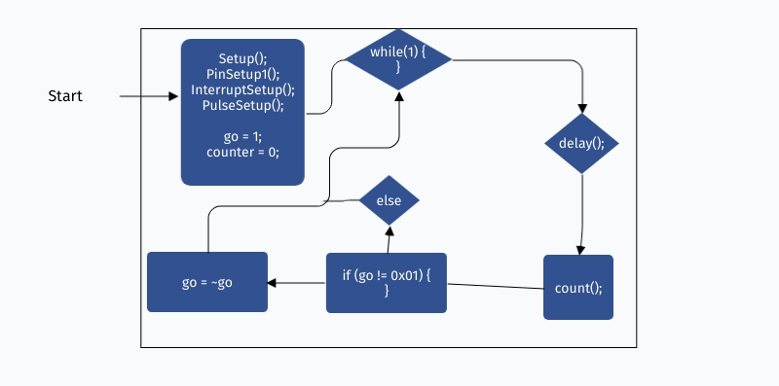
Flowchart
If (start)

Slide 3
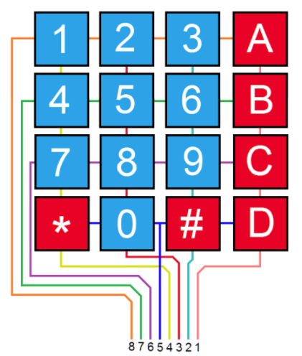
4x4 Keypad
Its Low Active (ex: Pressing 1 makes pin 8 and pin 4 go to 0)
Pressing a key triggers the interrupt handler. * and # hold a value for 3 seconds. And start/stop and reverse the decade counter

Slide 4
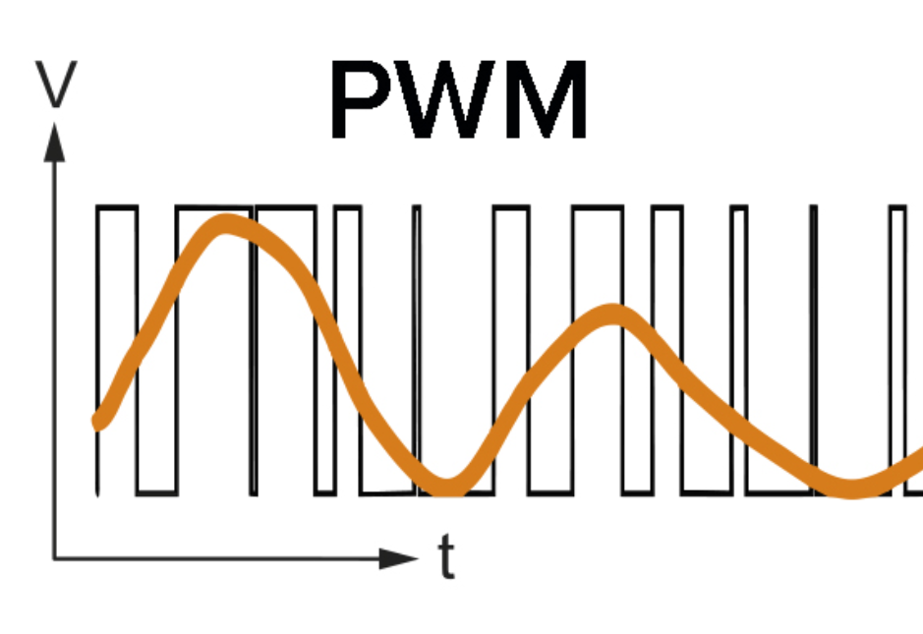
Pulse-Width Modulation (PWM)
Reducing the average power delivered by effectively chopping it up into discrete parts.

Slide 5
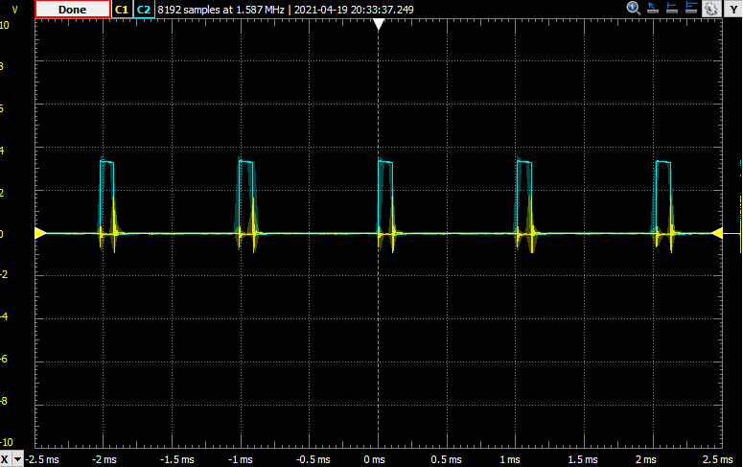
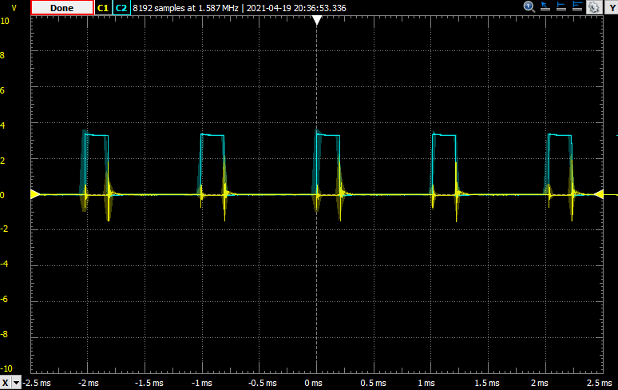
PWM (pressing keypad 1 and 2)
10%
20%

Slide 6
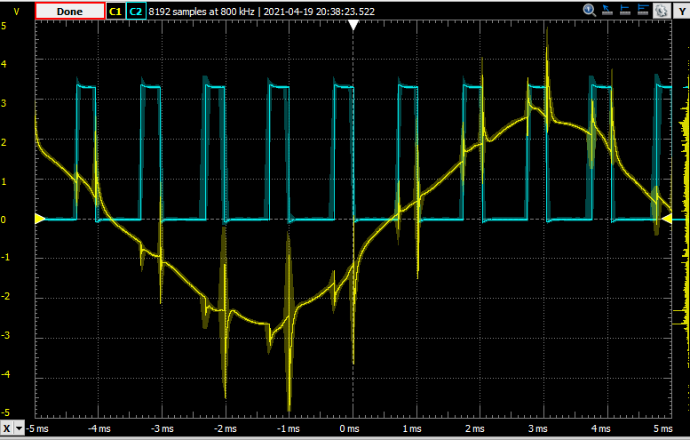
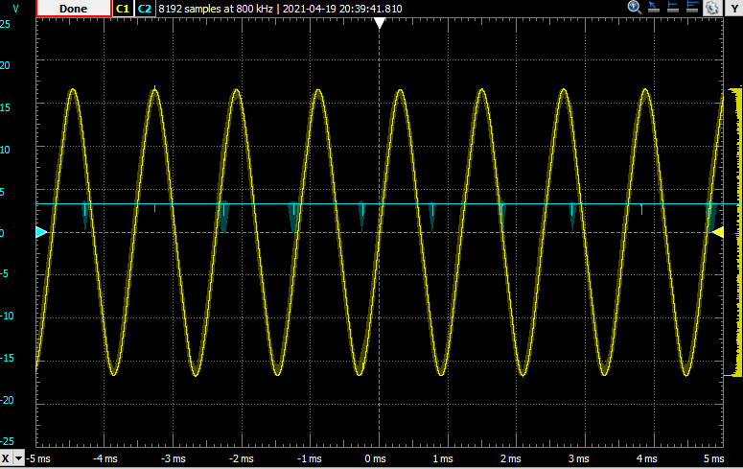
PWM (pressing Keypad 3 and A)
30%
100%

Slide 7
Tachometer
Measures the velocity of the motor.
We can measure the Frequency by taking the frequency of the Sine Wave (yellow on oscilloscope).
We can measure the Amplitude by taking the amplitude of Sine wave (yellow on oscilloscope).

Slide 8
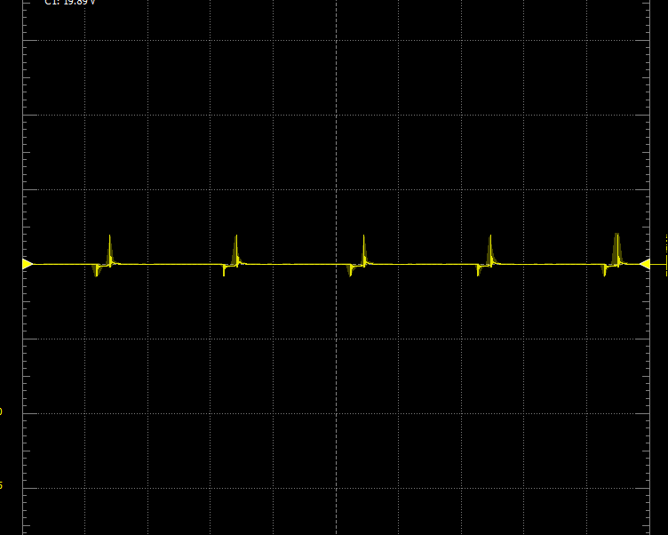
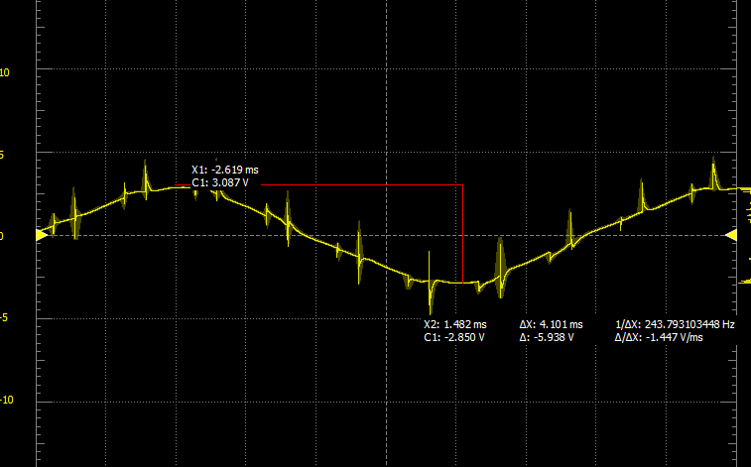
Tachometer
Motors are older and there's not enough voltage to display much signal from the tachometer for 10% and 20%
10% with just noise
30% with Sine wave and some noise

Slide 9
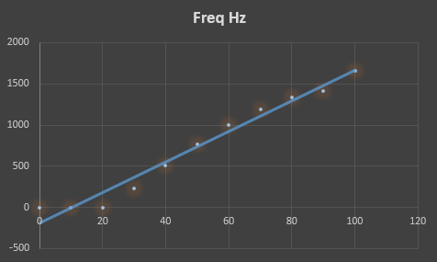
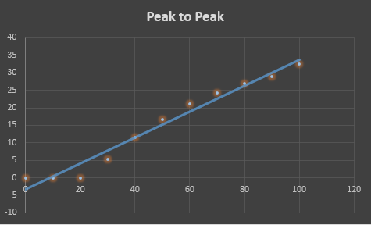
Tachometer
Both Frequency and Amplitude are linear as expected
Frequency of Motor
Amplitude

Slide 10
Counter
The counter is a decade counter which counts from 0-9 when the * start/stop key is pressed. Once the counter hits 9, the counter will restart counting from 0 until pressing the * start/stop button to stop the counter.
Once the direction button # is pressed, the counter will start counting from 9 to 0. Once the counter hits 0, it will start back from 9 and count down again until stopped by the * start/stop button.

Slide 11
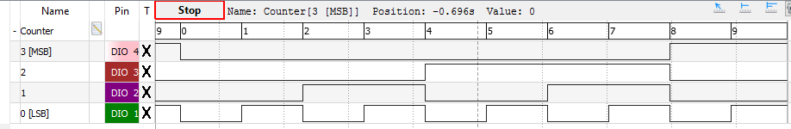
Counter
Logic Analyzer showing the counter counting from 0-9 and resetting

Slide 12
The End
This concludes the ELEC 3040/3050 presentation and lab

